Slide 1


SoC Week 1 Hackathon
Spooky Mansion Escape Room👻
Serge Huleani
Sarah Hunt
Sami Azil
29th November 2024

Slide 2
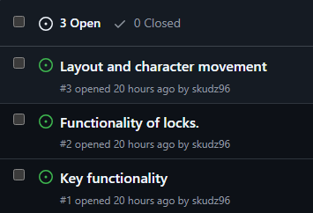

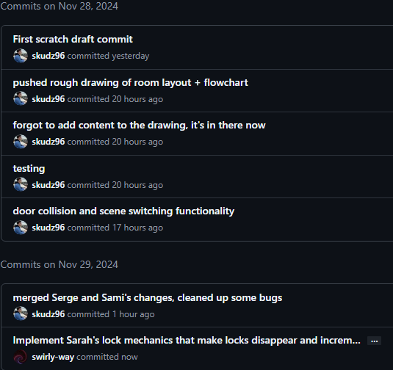
Reflection
AGILE Workflow:
Iterative development
Brief check-ins regarding progress in a Slack group we formed
Task ownership & collaboration. GitHub issues & assignments was great for this
Continuous feedback loop through consistent commits
Improvements for next time:

Slide 3
Flow diagram

Slide 4
MVP assignments
Serge – Layout and character movement
Sami – Key functionality
Sarah – Functionality of locks

